Slide 1
Organizational Structure and Design

Slide 2
Introduction
Organizational structure and design refer to the way an organization is arranged and how its different parts work together to achieve its goals. The structure of an organization includes its hierarchy of roles, responsibilities, and reporting relationships. The design of an organization involves decisions around how to organize and group its various functions, departments, and teams to optimize efficiency and effectiveness.
Common types of organizational structures include:
Functional: Organized by departments based on similar functions (e.g., marketing, finance, operations)
Divisional: Organized by product, customer, or geographic location
Matrix: Combines functional and divisional structures to create cross-functional teams
Flat: Minimal hierarchy with few layers of management
Factors that influence organizational design include the organization's size, complexity, culture, industry, and strategic goals. Effective organizational design can help to improve communication, reduce costs, increase efficiency, and support the organization's overall strategy.

Slide 3
Understanding an Organizational Structure
Businesses of all shapes and sizes use organizational structures heavily. They define a specific hierarchy within an organization. A successful organizational structure defines each employee's job and how it fits within the overall system. Put simply, the organizational structure lays out who does what so the company can meet its objectives.
This structuring provides a company with a visual representation of how it is shaped and how it can best move forward in achieving its goals.
Organizational structures are normally illustrated in some sort of chart or diagram like a pyramid, where the most powerful members of the organization sit at the top, while those with the least amount of power are at the bottom.
Not having a formal structure in place may prove difficult for certain organizations. For instance, employees may have difficulty knowing to whom they should report. That can lead to uncertainty as to who is responsible for what in the organization.

Slide 4
Centralized vs. Decentralized Organizational Structures
organizations have been structured with centralized leadership and a defined chain of command. The military is an organization famous for its highly centralized structure, with a long and specific hierarchy of superiors and subordinates.
In a centralized organizational system, there are very clear responsibilities for each role, with subordinate roles defaulting to the guidance of their superiors.
decentralized organizations. This allows companies to remain fast, agile, and adaptable, with almost every employee receiving a high level of personal agency. For example, Johnson & Johnson is a company that's known for its decentralized structure.
As a large company with over 200 business units and brands that function in sometimes very different industries, each operates autonomously. Even in decentralized companies, there are still usually built-in hierarchies. However, teams are empowered to make their own decisions and come to the best conclusion without necessarily getting "approval" from up top.

Slide 5
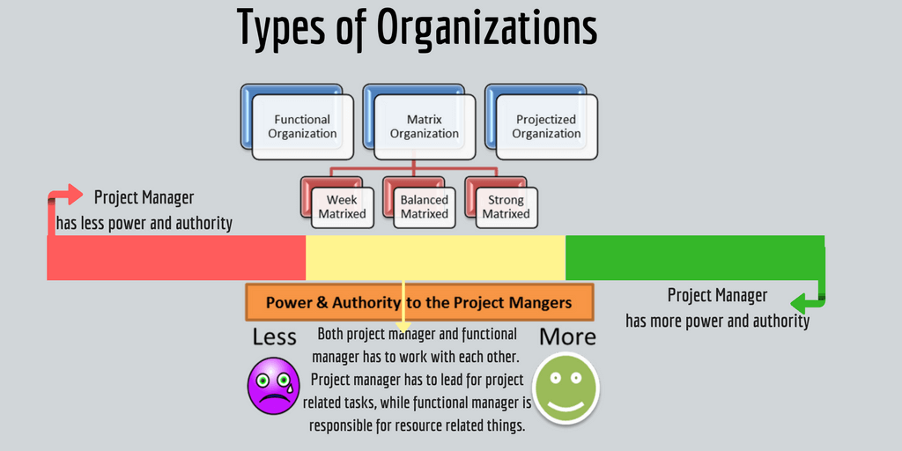
Types of Organizational Structures
Functional Structure- This is also referred to as a bureaucratic organizational structure and breaks up a company based on the specialization of its workforce. Most small-to-medium-sized businesses implement a functional structure. Dividing the firm into departments consisting of marketing, sales, and operations is the act of using a bureaucratic organizational structure.
Divisional or Multidivisional Structure- The second type is common among large companies with many business units. Called the divisional or multidivisional (M-Form) structure, a company that uses this method structures its leadership team based on the products, projects, or subsidiaries they operate. A good example of this structure is Johnson & Johnson. With thousands of products and lines of business, the company structures itself so each business unit operates as its own company with its own president.

Slide 6
Cont..
Team-Based-Similar to divisional or functional structures, team-based organizations segregate into close-knit teams of employees that serve particular goals and functions, but where each team is a unit that contains both leaders and workers.
Flat (Flatarchy) Structure- Flatarchy, also known as a horizontal structure, is relatively newer, and is used among many startups. As the name alludes, it flattens the hierarchy and chain of command and gives its employees a lot of autonomy. Companies that use this type of structure have a high speed of implementation.
Matrix Structure- Firms can also have a matrix structure. It is also the most confusing and the least used. This structure matrixes employees across different superiors, divisions, or departments. An employee working for a matrixed company, for example, may have duties in both sales and customer service.

Slide 7
Cont..
Circular Structure- Circular structures are hierarchical, but they are said to be circular as it places higher-level employees and managers at the center of the organization with concentric rings expanding outward, which contain lower-level employees and staff. This way of organizing is intended to encourage open communication and collaboration among the different ranks.
Network Structure-The network structure organizes contractors and third-party vendors to carry out certain key functions. It features a relatively small headquarters with geographically-dispersed satellite offices, along with key functions outsourced to other firms and consultants.

Slide 8
Benefits of Organizational Structures
The structure also makes operations more efficient and much more effective. By separating employees and functions into different departments, the company can perform different operations at once seamlessly.
In addition, a very clear organizational structure informs employees on how best to get their jobs done. For example, in a hierarchical organization, employees will have to work harder at buying favor or courting those with decision-making power. In a decentralized organization, employees must take on more initiative and bring creative problem solving to the table.
This can also help set expectations for how employees can track their own growth within a company and emphasize a certain set of skills—as well as for potential employees to gauge if such a company would be a good fit with their own interests and work styles.

Slide 9
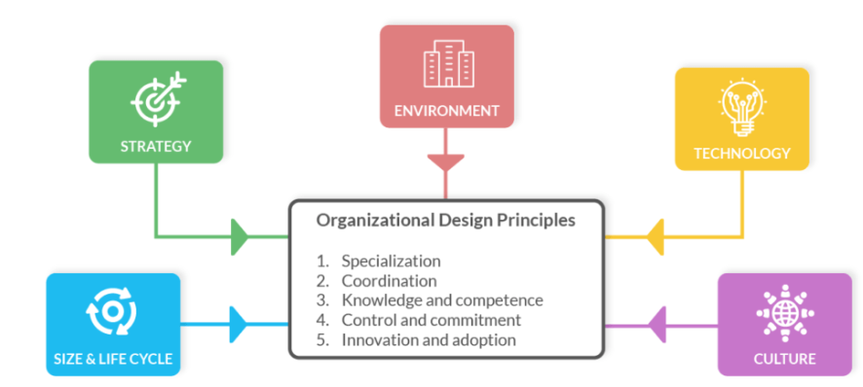
Factors that influence organizational design

Slide 10
Cont..
Strategy: An organization's strategy is a key factor in determining its design. The design must align with the organization's strategic goals and support its overall mission.
Size: The size of an organization can impact its design. Smaller organizations may have a more informal and flat structure, while larger organizations may require a more formal and hierarchical structure.
Environment: The external environment in which an organization operates can influence its design. For example, organizations in highly regulated industries may require a more centralized structure to comply with regulations.
Technology: The technology an organization uses can impact its design. Organizations that rely heavily on technology may require a flatter structure to promote innovation and collaboration.
Culture: The culture of an organization can impact its design. Organizations with a culture of collaboration and teamwork may require a more decentralized and flat structure.
Human Resources: The skills and abilities of employees can impact an organization's design. For example, an organization with a highly skilled workforce may require a flatter structure to promote innovation and collaboration.

Slide 11
Benefits of organizational design
Clarity in operations- Adopting an efficient organizational design is important for every organization, regardless of size. It clarifies a company's daily operations and the process of making key decisions and other activities. A practical design provides an overview of each stakeholder's role. This helps employees understand their responsibilities, the timeframe to complete specific projects, the tasks to prioritize, and who they can contact when they need help. A good organizational design can significantly affect efficiency, particularly in large corporations.
Growth opportunities-An organization with an efficient design can take advantage of growth opportunities more easily. An excellent organizational design encompasses a technological infrastructure. It's also beneficial when a manager is considering hiring a new employee. The organization's design stipulates specific measures to follow when hiring new people.
Adaptability to change- A key feature of an effective design is the ability to respond to a changing marketplace and industry conditions. Many company leaders prefer to focus on existing operations, but the best design allows space for new trends. Ideally, a practical design is flexible enough to allow for any adjustments when necessary.

Slide 12
8 organizational design principles to consider
Work specialization- The principle of work specialization is a key element of organizational design. A manager typically delegates various responsibilities to employees. An employee's skills, qualifications, job role, and abilities determine how a manager can delegate their work. For example, asking an accountant to prepare a list of materials a company requires to maintain production isn't efficient. When everyone in the organization follows the work specialization principle, the employees can complete their tasks quickly with high quality.
Unity of command- A company's communication hierarchy is the focus of the unity of command principle. The communication hierarchy outlines the relationship between an organization's leadership and its employees. It's important for every employee to report to their immediate manager when discussing daily activities. The unity of command principle creates a proper flow of information within a company. For example, the managing director can instruct the marketing manager, and the marketing manager reports directly to only the managing director. A marketing manager can have authority over a sales manager, who is in charge of their sales representatives.

Slide 13
Cont..
Control or supervision- The control or supervision principle focuses on the number of employees a manager can work with efficiently. It's important for the manager to be able to supervise the employees who report to them. The number of employees a manager oversees depends on their competence and abilities, along with the work of the team. The following describes the span of control a manager may have in their role:
Wide span of control: This happens when a manager oversees a large group of employees efficiently. A wide span of control can occur in environments where work is repetitive, communication is excellent, employees require little help, and teams respond promptly.
Narrow span of control: This happens when a manager oversees a small group of employees. A narrow span of control works when the team requires continuous supervision, they have less coordination, there's some miscommunication, or the job requires specific specialization.

Slide 14
Cont..
Coordination of departments and compartments- A larger organization comprises various departments and compartments. This design principle allows the teams within each department or compartment to focus on specific tasks. It's important to coordinate the various activities in the company, so each department or compartment can work together efficiently. Here are the differences between a department and a compartment:
Compartments: This refers to the group of professionals who each come from different career paths and specialties. These professionals use their skills to complete a project together.
Departments: This refers to the group of professionals with similar skill sets in a company. Each individual typically has the same duties in the department and uses the same practices to achieve a goal.

Slide 15
Cont..
Balance of responsibilities- It's important for managers to ensure every employee has an equal amount of work. Having a balance of responsibilities helps to reduce the chances of conflict among the team members. It also ensures the company uses the employee's time and skills effectively. This principle usually benefits employees because it can provide everyone with equal opportunities to perform.
Functional definition- A clear definition of responsibility and authority between leadership, management, and employees can be key. If there's no clear definition of specific responsibilities, there's a possibility that the work can remain incomplete. For example, a restaurant may require someone to turn off all the electrical appliances at the end of the day. If this responsibility goes unassigned, the restaurant can't hold an employee accountable if the electrical appliances stay on throughout the night. Telling everyone their responsibilities can ensure that they complete their work without delay.
Simplicity of communication- Simplifying the authority of communication throughout an organization can result in less confusion among employees about who they can approach when facing challenges. Creating simplicity means clearly delegating authority in an organizational design. For example, a customer service representative reports to a manager, but the manager doesn't report to the customer service representative. Having a short chain of command can reduce confusion and delays in the decision-making process. This can also reduce any coordination and communication challenges throughout the company.
Adaptability to change-Being able to adapt to change is beneficial for an organization. Creating an organizational design that's flexible enough to adapt to certain circumstances is important. For example, it's important for an employee to know who they can report to when a manager suddenly isn't available. Flexibility allows an organization to grow faster than a company that's not ready for change.

Slide 16
Evaluating the effectiveness of an organizational design
Using the principles of organizational design can result in an effective organization. This means the company can achieve its goals. Evaluating an organizational design can help you identify improvement areas. Here are some approaches you can use to evaluate an organizational design:
Resources-based approach: This approach assesses an organization's effectiveness on whether it can get the resources it requires for high performance.
Internal process approach: This focuses on an organization's production process and determines its effectiveness using internal economic efficiency.
Goal approach: This focuses on assessing an organization's effectiveness by monitoring how well it can reach its operational goals.

